Slide 1
Bayes Theorem

Slide 2
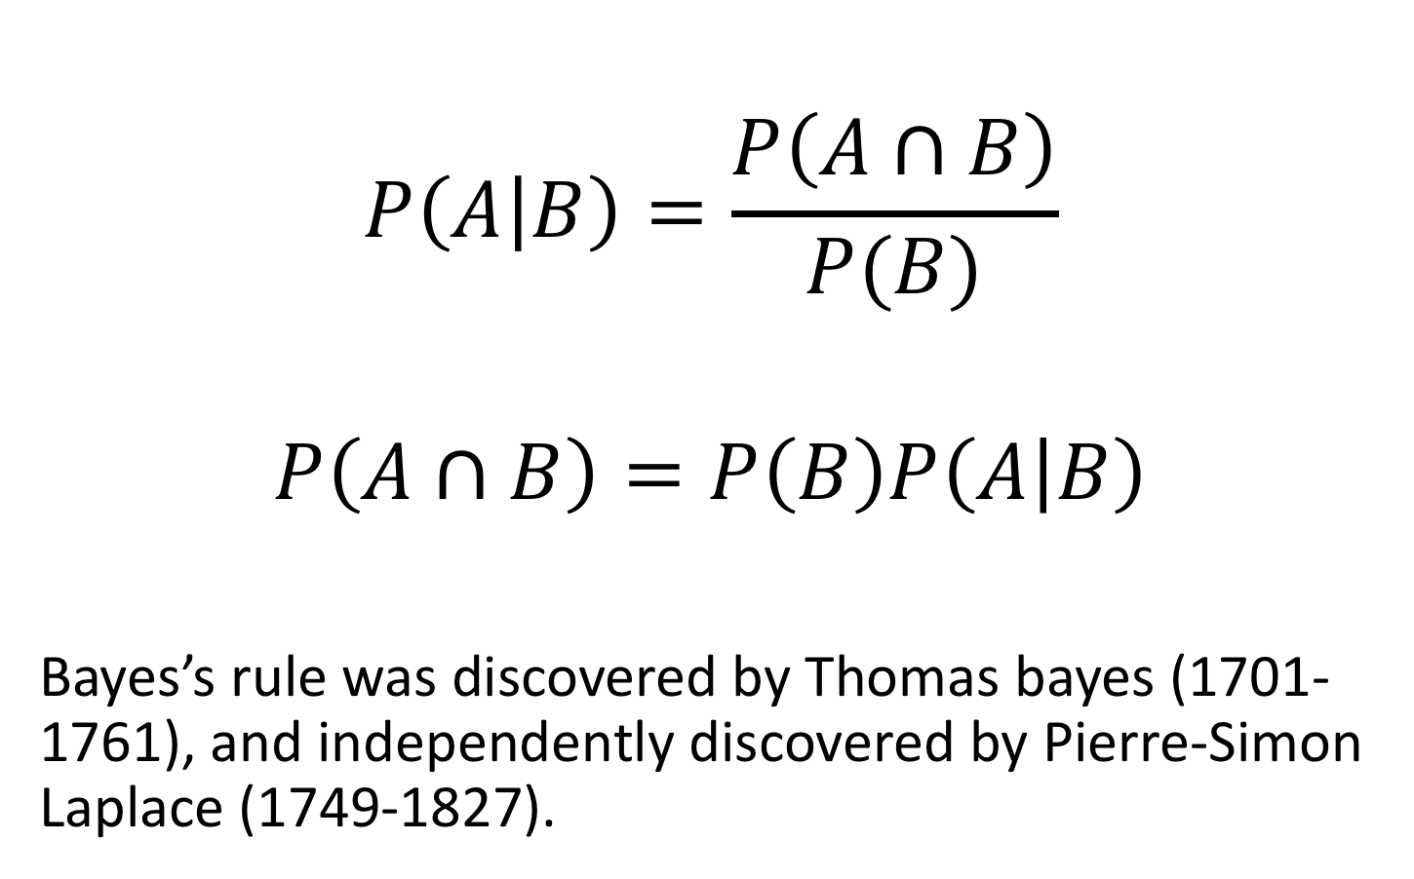
Bayes Theorem
$$P\left(A | B\right)=\frac{P\left(A∩B\right)}{P(B)}$$
$$P\left(A∩B\right)=P\left(B\right)P\left(A | B\right)$$
Bayes’s rule was discovered by Thomas bayes (1701-1761), and independently discovered by Pierre-Simon Laplace (1749-1827).

Slide 3

Bayes theorem
likelihood
Marginal probability does not depend on θ, so can remove to obtain unnormalised posterior probability…
prior distribution
posterior distribution
marginal probability

Slide 4
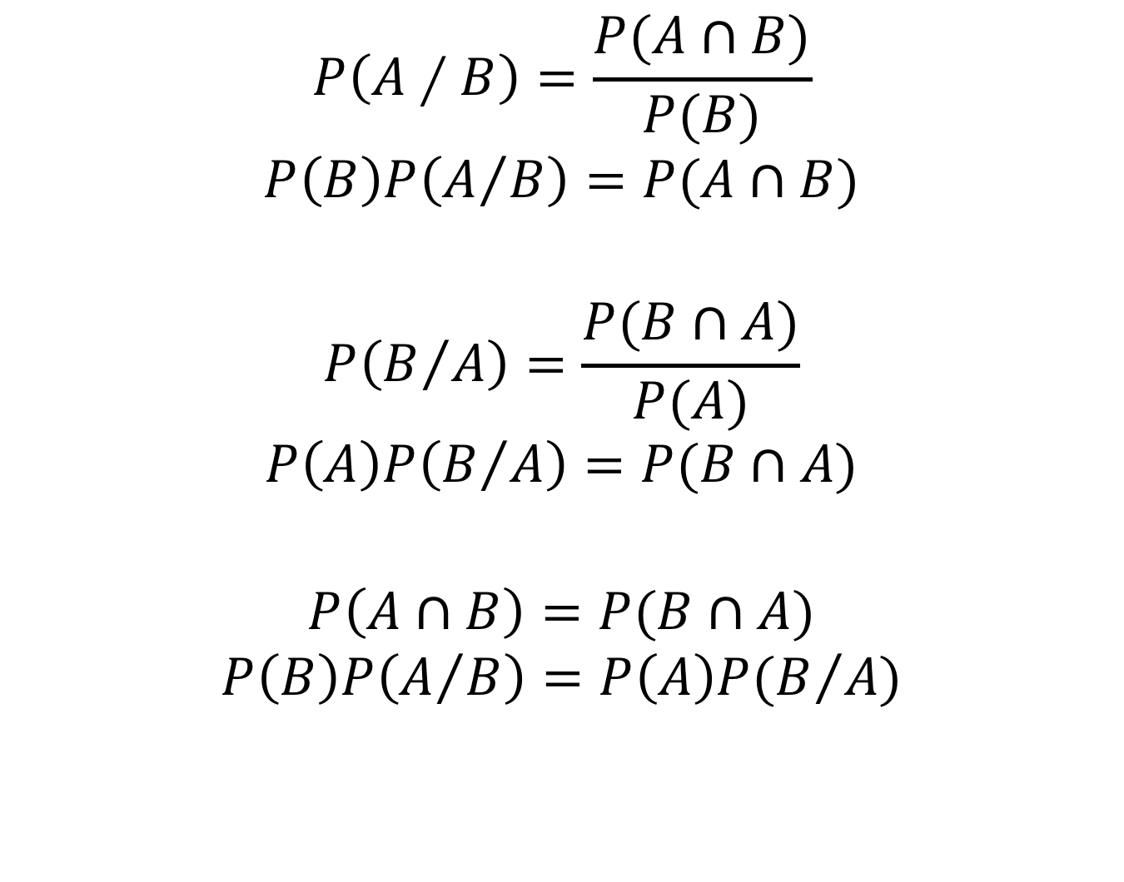
Bayesian Theorem
$$P\left(A∕B\right)=\frac{P(A∩B)}{P(B)}$$
$$P\left(B\right)P\left(A/B\right)=P(A∩B)$$
$$P\left(B/A\right)=\frac{P(B∩A)}{P(A)}$$
$$P\left(A\right)P\left(B/A\right)=P(B∩A)$$
$$P\left(A∩B\right)=P(B∩A)$$
$$P\left(B\right)P\left(A/B\right)=P\left(A\right)P(B/A)$$

Slide 5
Example 1
A disease occurs in 5% of population
A diagnostic test gives a positive result
in 99% of people that have the disease
in 5% of people that do not have the disease (false positive)
A random person from the street is found to be positive on this test. What is the probability that they have the disease? P(A/B)
A: 0-30%
B: 30-60%
C: 60-90%

Slide 6
Example 1
A disease occurs in 5% of population
A diagnostic test gives a positive result
in 99% of people that have the disease
in 5% of people that do not have the disease (false positive)
A = disease
B = positive test result
P(A) = 0.05 probability of having disease
P(~A) = 1 – 0.05 = 0.95 probability of not having disease
conditional probabilities
P(B|A) = 0.99 probability of positive result given you have disease
P(~B|A) = 1 – 0.99 = 0.01 probability of negative result given you have disease
P(B|~A) = 0.05 probability of positive result given you do not have disease
P(~B|~A) = 1 – 0.05 = 0.95 probability of negative result given you do not have disease

Slide 7
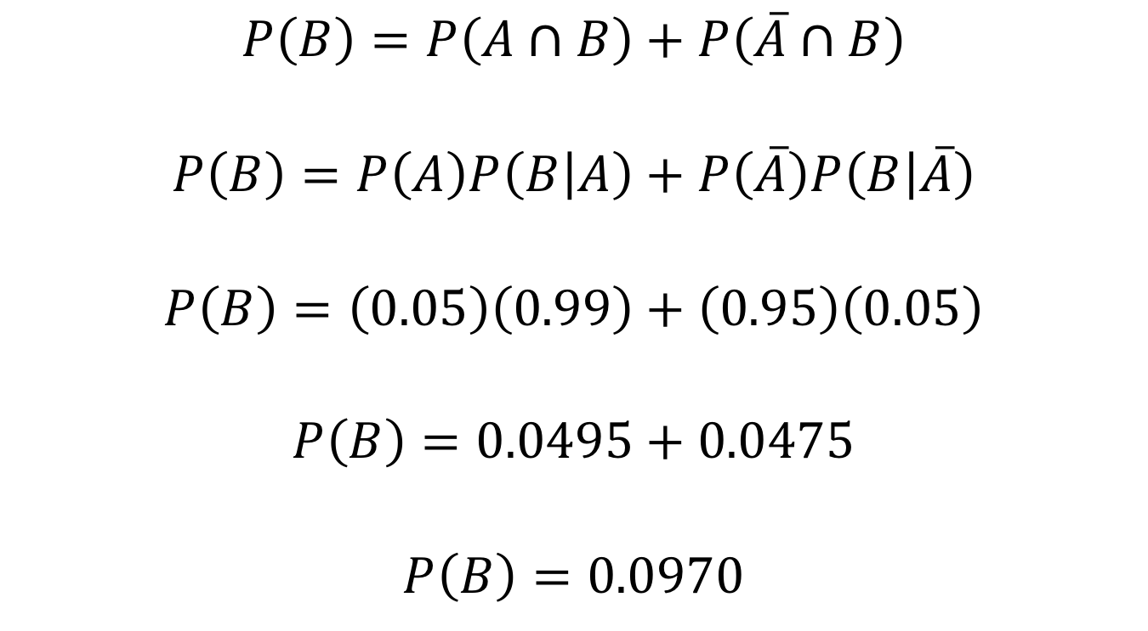
Example 1
$$P\left(B\right)=P\left(A∩B\right)+P\left(\overline{A}∩B\right)$$
$$P\left(B\right)=P\left(A\right)P\left(B | A\right)+P\left(\overline{A}\right)P\left(B | \overline{A}\right)$$
$$P\left(B\right)=\left(0.05\right)\left(0.99\right)+\left(0.95\right)\left(0.05\right)$$
$$P\left(B\right)=0.0495+0.0475$$
$$P\left(B\right)=0.0970$$

Slide 8
A = disease
B = positive test result
population = 100
positive test result P(B)
=0.0970
disease P(A)
0.05

Slide 9
A = disease
B = positive test result
P(A⋂B) is the joint probability, or the
probability that both events occur.
P(A⋂B) is the same as P(B⋂A).
But we already know that the
test was positive, so we have to
take that into account.
Of all the people already in
the green circle, how many
fall into the P(A⋂B) part? That’s
the probability we want to
know!
That is:
P(A|B) = P(A⋂B) / P(B)
You can write down same thing
for the inverse:
P(B|A) = P(A⋂B) / P(A)
The joint probability can be expressed
in two ways by rewriting the equations
P(A⋂B) = P(A|B) * P(B)
P(A⋂B) = P(B|A) * P(A)
Equating the two gives
P(A|B) * P(B) = P(B|A) * P(A)
P(A|B) = P(B|A) * P(A) / P(B)
population = 100
positive test result P(B)
=0.0970
P(B⋂~A)
disease P(A)
0.05
P(A⋂B)
P(A⋂~B)

Slide 10
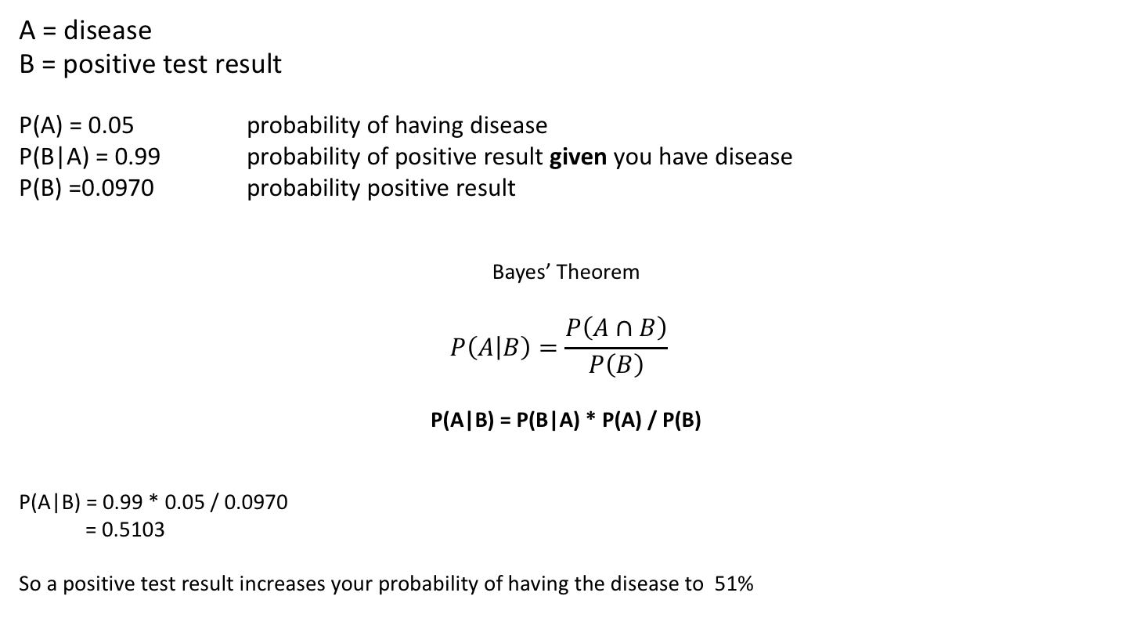
Example 1
A = disease
B = positive test result
P(A) = 0.05 probability of having disease
P(B|A) = 0.99 probability of positive result given you have disease
P(B) =0.0970 probability positive result
Bayes’ Theorem
$$P\left(A | B\right)=\frac{P\left(A∩B\right)}{P\left(B\right)}$$
P(A|B) = P(B|A) * P(A) / P(B)
P(A|B) = 0.99 * 0.05 / 0.0970
= 0.5103
So a positive test result increases your probability of having the disease to 51%

Slide 11
Bayes Theorem
P(A) is called the prior:
before we have any information, we estimate the chance of having the disease 5%
P(B|A) is called the likelihood:
probability of the data (positive test result) given an underlying cause (disease)
P(B) is the marginal probability of the data:
the probability of observing this particular outcome, taken over all possible values of A (disease and no disease)
P(A|B) is the posterior probability:
it is a combination of what you thought before obtaining the data, and the new information the data provided (combination of prior and likelihood)

Slide 12
Example 2
It rains on 20% of days.
When it rains, it was forecasted 80% of the time
When it doesn’t rain, it was erroneously forecasted 10% of the time.
The weatherman forecasts rain. What’s the probability of it actually raining?
A = It rains
B = It was forecasted to rain
What information is given in the story?
P(A) = 0.2 (prior)
P(B|A) = 0.8 (likelihood)
P(B|~A) = 0.1

Slide 13
Example 2
What is P( B), probability of rain forecast? Calculate over all possible values of B (marginal probability)
P(B) =P(B|A) * P(A) + P(B|~A) * P(~A)
= 0.8 * 0.2 + 0.1 * 0.8
= 0.24
P(A|B) = P(B|A) * P(A) / P(B)
P(A|B) = 0.8 * 0.2 / 0.24
= 0.67
So before you knew anything you thought P(rain) was 0.2. Now that you heard the weather forecast, you adjust your expectation upwards
P(rain|forecast) = 0.67

Slide 14
Bayes Theorem
P(A) is called the prior:
before we have any information, we estimate the chance of having the rain 20%
P(B|A) is called the likelihood:
probability of the data (forecast) given that it will rain
P(B) is the marginal probability of the data:
the probability of observing this particular outcome, taken over all possible values of A (rain and no rain)
P(A|B) is the posterior probability:
it is a combination of what you thought before obtaining the data, and the new information the data provided (combination of prior and likelihood)

Slide 15
Bayes Theorem
Probability
Priors
All of which brings you to…

Slide 16
Bayes Theorem
P (θ|data) ∝ P (data|θ).P(θ)
i.e. posterior information is proportional to conditional x prior
Given a prior state of knowledge, can update beliefs based on observations

Slide 17
Classical approach | Bayesian approach
Fixed ‘true’ θ | Unknown quantity that has probability distribution (i.e. account for uncertainty)
Confidence intervals: if collect data lots of times, the interval we construct will contain θ on 95% of occasions | Confidence interval: 95% probability that θ lies within this interval
P-value is probability data is observed if the null hypothesis is true i.e. can only reject NH | Can get probabilities of null and alternative models, so can accept the null hypothesis
Assumptions for convenience e.g. noise normally distributed | Can use previous knowledge combined with current data (i.e. use prior)
Make inferences on probability of the data given the model i.e. P (data|θ) | Make inferences on the probability of the model given the data i.e. P (θ|data) (i.e. the inverse)
Compare nested models (reduced vs full model) | Compare any models of the same data (Bayesian model comparison)
Notes:
Mistake with CI – 95% proability that true population value of theta lies in this interval, but we assume theta has a fixed ‘true’ value, so this is not correct,(unless theta has a distribution) ie theta is either in the interval or not
Adding variable imprpve explanatory power = nested

Slide 18
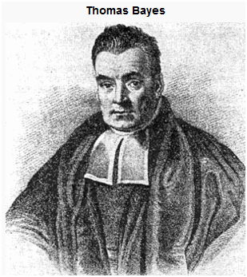
Summary
Take uncertainty into account
Incorporate prior knowledge
Invert the question (i.e. how good is our hypothesis given the data)
Used in many aspects of (neuro)science
https://www.onlinemathlearning.com/bayes-theorem.html
c. 1701 – 1761

